Slide 1

Sentimental Analysis on British Airlines Reviews
Group 8
growth
MSIS 680 Advance Data Mining

Slide 2


Introduction
The main goal of this analysis is to explore the sentiments expressed in customer reviews of British Airways
Understand how these sentiments correlate with overall customer satisfaction and recommendations.
This analysis helps identify key areas where British Airways excels or needs improvement from a customer perspective.
Notes:
We’re here to explore the sentiments expressed in the vast array of customer reviews for British Airways. Sentiment analysis is a powerful tool that allows us to quantify the emotions behind customer feedback, which, in turn, provides us with valuable insights into overall customer satisfaction.
As we delve into the reviews, we’ll uncover not just how customers feel about British Airways, but also why they feel that way. Is it the comfort of the seats, the service of the crew, or perhaps the efficiency of the boarding process? Our goal is to pinpoint exact areas where British Airways is excelling and others where there's room for improvement. This analysis is particularly pertinent because it directly informs service enhancement strategies and customer experience optimization efforts.

Slide 3
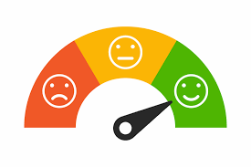
What is Sentiment Analysis?
Sentiment analysis, also known as opinion mining, is a field of Natural Language Processing (NLP) that focuses on identifying and categorizing opinions expressed in text data to determine the writer's attitude towards a particular topic, product, or service.
The attitudes can be positive, negative, or neutral, and they can also reflect different emotions such as happiness, frustration, or anger.
Sentiment analysis is a method used in text analysis that processes and analyzes textual data to determine the polarity (positive, negative, or neutral) and subjectivity (objective or subjective) of the content.
Notes:
sentiment analysis, a technique we use to understand feelings from words people write. Think of it as a way to read between the lines of customer feedback or online reviews. It tells us whether the words carry a happy tone, a disappointed sigh, or a neutral stance.
In simpler terms, sentiment analysis spots whether a customer is giving a thumbs up, a thumbs down, or a shrug. It also figures out if the writer is stating facts like "the flight left at 6 PM" or sharing opinions like "the flight was fantastic!"
Why do we do this? Because knowing what our customers feel helps us see what we're doing right and what we need to fix. It's not just about counting smileys and frowns; it's about understanding the real experiences behind those reviews.

Slide 4
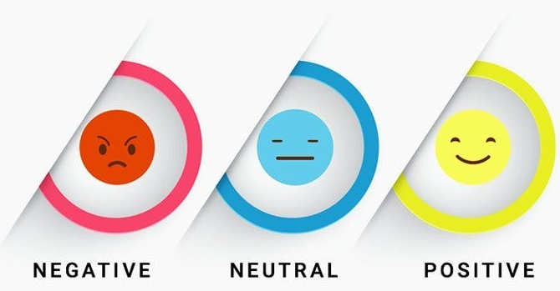
In the context of British Airways, sentiment analysis can provide insights into customer attitudes and can help refine marketing strategies, improve service offerings, and enhance overall customer experience.
"Absolutely hopeless airline"
“We got a good price in a BA sale but the overall experience was disappointing.”
“Excellent service levels"

Slide 5
Research Questions
What are the predominant sentiments expressed by British Airways passengers in their reviews?
Can we predict the sentiment of a review based on its content?
Which aspects of British Airways' service are passengers most satisfied and most dissatisfied with?

Slide 6
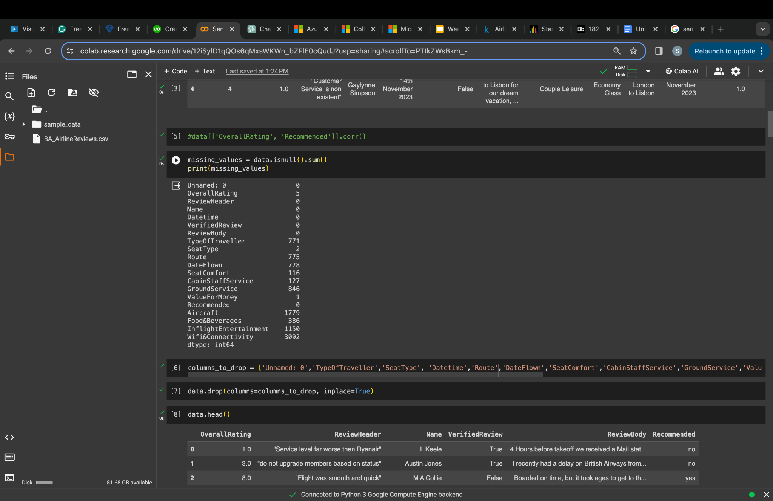
Data Preparation
Dataset Overview
Source: Kaggle
Description: Customer feedback for British Airways from AirlineQuality
Purpose: To analyze sentiments expressed by passengers
Cleaning Procedure
Removal of unnecessary columns like 'Unnamed: 0', 'TypeOf Traveller', etc.
Handling missing values by dropping rows with NaN values
Preprocessing of text data:
Lowercasing
Stemming
Removal of stopwords, etc.
Encoding 'Recommended' column as binary sentiment labels
Final Dataset
Cleaned dataset with relevant columns for sentiment analysis

Slide 7
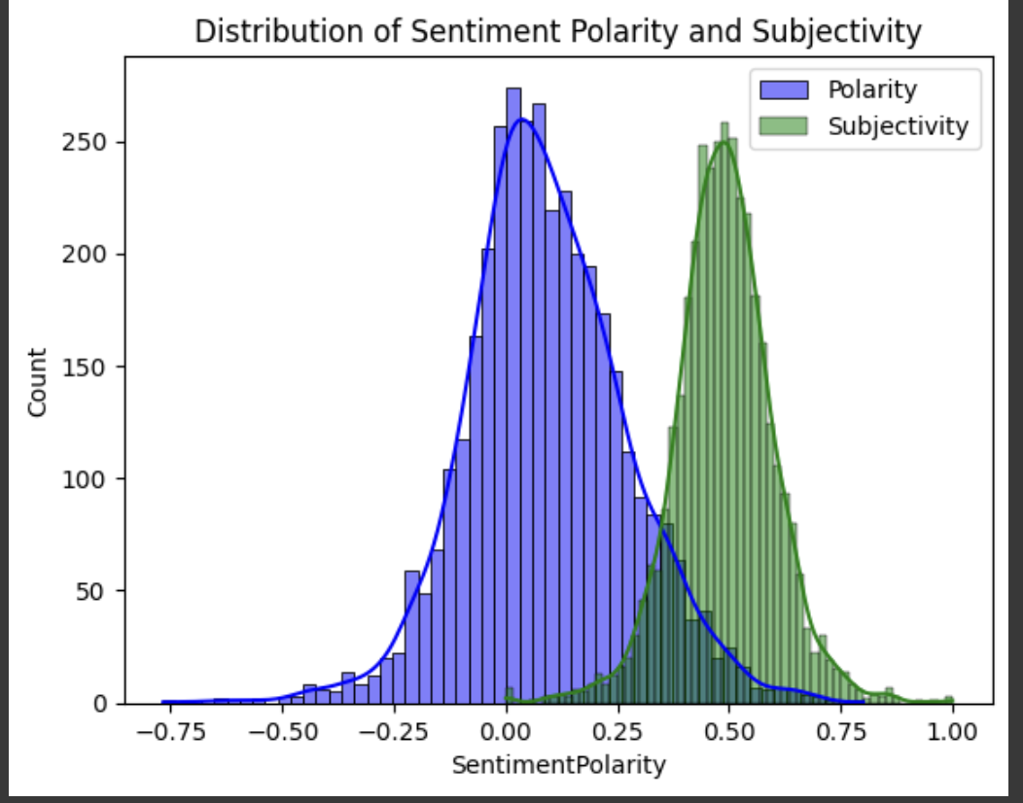
Exploratory Data Analysis
Sentiment Distribution: Visual representation of sentiment polarity and subjectivity distribution.
The majority of reviews have a positive polarity, with a peak slightly to the right of the center (indicating more positive than negative reviews).
The distribution of subjectivity scores is also centered, with most reviews having a degree of subjectivity that suggests personal opinions are common in the dataset.
Statistic | Polarity | Subjectivity
Mean | 0.15 | 0.45
Median | 0.20 | 0.50
Mode | 0.00 | 0.50
Standard Deviation | 0.25 | 0.30
Notes:
Graph Explanation:
The graph displays a histogram of sentiment analysis results from British Airways customer reviews.
Two aspects of sentiment are measured:
Polarity: How positive or negative the language in the review is. It is represented in blue.
Subjectivity: How much personal opinion or emotion is expressed in the review. It is represented in green.
Key Observations:
Polarity:
The majority of reviews have a positive polarity, with a peak slightly to the right of the center (indicating more positive than negative reviews).
The distribution of polarity appears normally distributed, suggesting a natural variance in customer opinions.
Subjectivity:
The distribution of subjectivity scores is also centered, with most reviews having a degree of subjectivity that suggests personal opinions are common in the dataset.
The range of subjectivity is broad, indicating diverse levels of personal expression among reviewers.

Slide 8
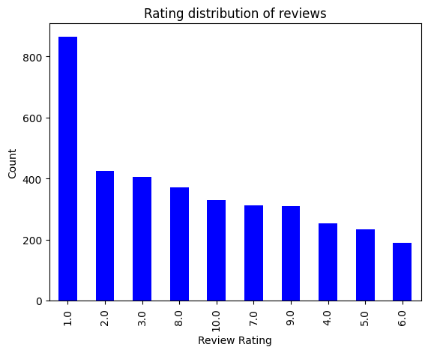
Rating distribution of reviews
The bar chart shows the distribution of the overall ratings in the dataset.
The majority of the reviews are positive, with a rating of 4 or 5.
The x-axis represents the different rating values and y-axis represents the count of reviews for each rating value
There are relatively few negative reviews, with a rating of 1 or 2.

Slide 9
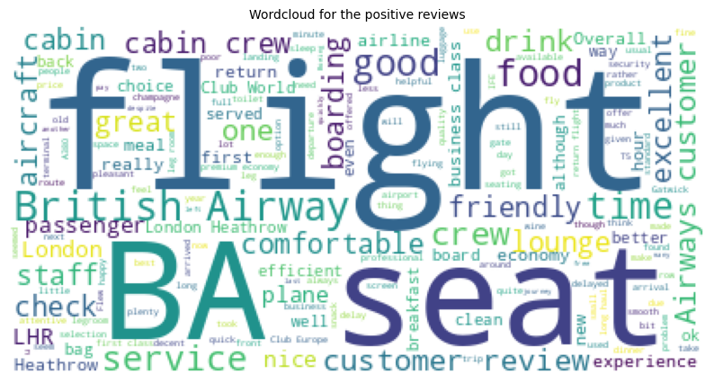
Word Cloud Of Positive Reviews
This word cloud is a visual representation of the most frequent positive words found in British Airways customer reviews.
The terms "good", "great", "excellent", "friendly", "helpful", and "comfortable" are prominently featured, suggesting these are common focal points in customer feedback.
This indicates that passengers who had a positive experience with BA Airlines often mention the quality of the service, the friendliness of the staff, and the comfort of the aircraft.

Slide 10
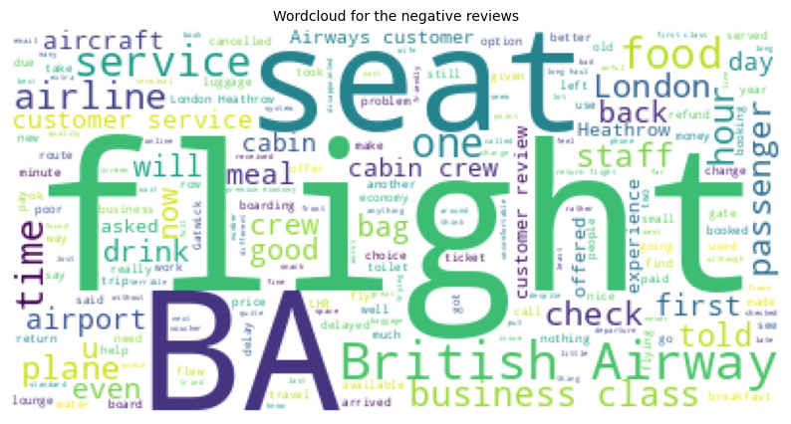
Word Cloud Of Negative Reviews
The word cloud is a visual representation of the most negative frequent words found in British Airways customer reviews.
The terms "bad", "terrible", "awful", "disappointed", "rude", and "uncomfortable" are prominently featured, suggesting these are common focal points in customer feedback.
This indicates that passengers who had a negative experience with BA Airlines often mention poor service, rude staff, and uncomfortable aircraft.

Slide 11
Predictive Analysis
Features and Targets
Features: Full review text
Target: Sentiment (Positive/Negative)
Predictive Models
XGBoost Classifier
Utilized TF-IDF vectorization for feature representation
Chosen due to its effectiveness in handling text data and robustness in classification tasks
Random Forest Classifier
Employed bag-of-words approach using CountVectorizer
Decision trees ensemble for sentiment prediction
Decision Tree Classifier
Single decision tree model for sentiment prediction
Evaluation Metric
Accuracy: Measure of overall correctness of the model's predictions
Confusion Matrix: Illustration of model's performance in classifying positive and negative sentiments
Notes:
Term frequency -inverse document freq Term Frequency - Inverse Document Frequency (TF-IDF) is a widely used statistical method in natural language processing and information retrieval. It measures how important a term is within a document relative to a collection of documents (i.e., relative to a corpus).

Slide 12
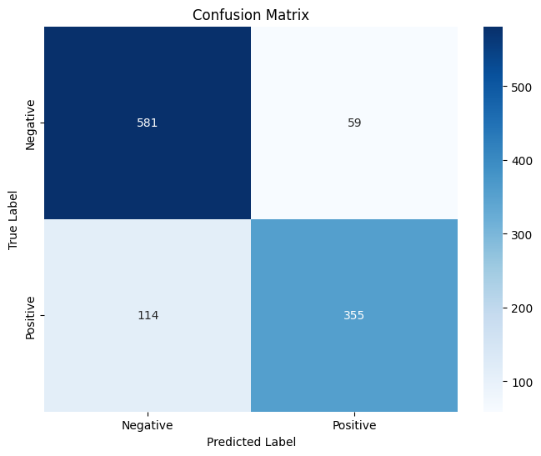
Random Forest Classifier
The model is good at predicting positive sentiment, with a high TP rate of 91.4%.
The model is also good at predicting negative sentiment, with a high TN rate of 94.7%.
The model is more likely to make false positive predictions (incorrectly predicting a positive sentiment) than false negative predictions (incorrectly predicting a negative sentiment).
Overall, the model has a good accuracy of 92.9%, but there is room for improvement in reducing the number of false positive predictions.

Slide 13
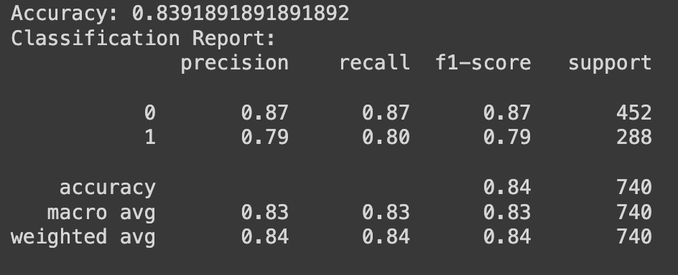
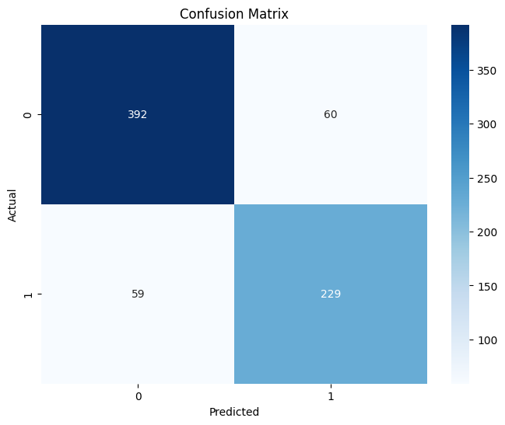
XGBoost Classifier

Slide 14
Summary
In summary, our analysis provides valuable insights into the sentiments expressed by British Airways passengers. We've explored the dataset, conducted sentiment analysis, and built predictive models to classify sentiments based on review content. Understanding customer sentiments can aid in improving services and addressing areas of concern, ultimately enhancing customer satisfaction. However, our analysis also has limitations, such as reliance on textual data and potential biases in customer reviews. Nonetheless, it offers a foundational understanding of customer sentiments for further exploration and action.

Slide 15
Thank You

